Slide 1

A world of activities by
Cambridge Data Champions
Marta Busse-Wicher
Sergio Martínez Cuesta
Office of Scholarly Communication
Department of Chemistry and CRUK-CI
Cambridge, 15th November 2017
Engaging Researchers in Good Data Management

Slide 2
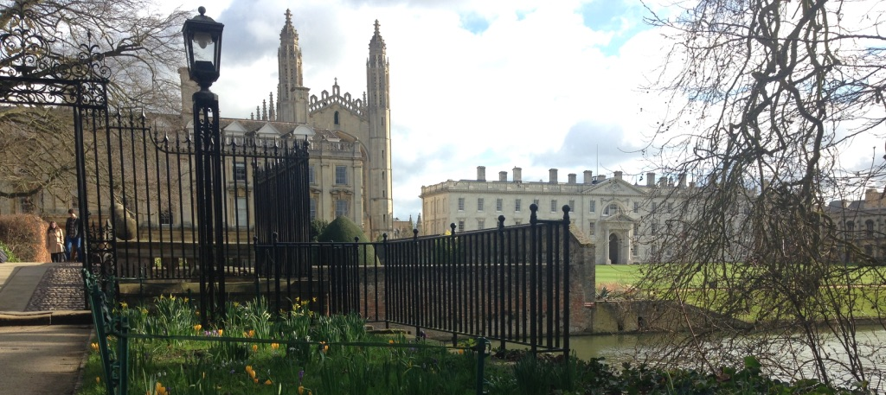
University of Cambridge
“With more than 18,000 students from all walks of life and all corners of the world, over 11,000 staff, 31 Colleges and 150 Departments, Faculties, Schools and other institutions, no two days are ever the same at the University of Cambridge.”
https://www.cam.ac.uk/about-the-university/how-the-university-and-colleges-work

Slide 3

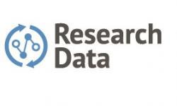

Office of Scholarly Communication
Group of ~20, headed by Dr Danny Kingsley
Including Research Data, headed by Dr Lauren Cadwallader
Data Policies
Data Repository
Data Sharing
Data Management Plans
Research Data Management Training
Why were Champions needed to start with?

Slide 4

The Problem(s): Mission impossible
High demand for training
Need to raise awareness of RDM across the research community
Wide variety of disciplines to serve
Limited resources
Slide by Dr Marta Teperek

Slide 5

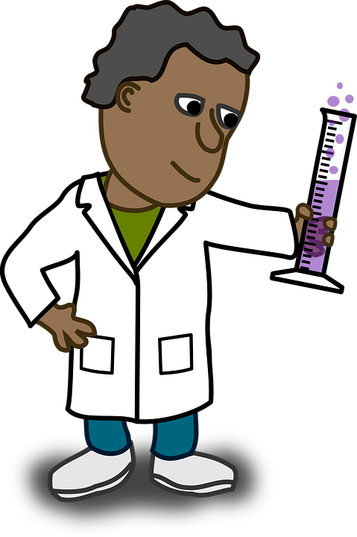
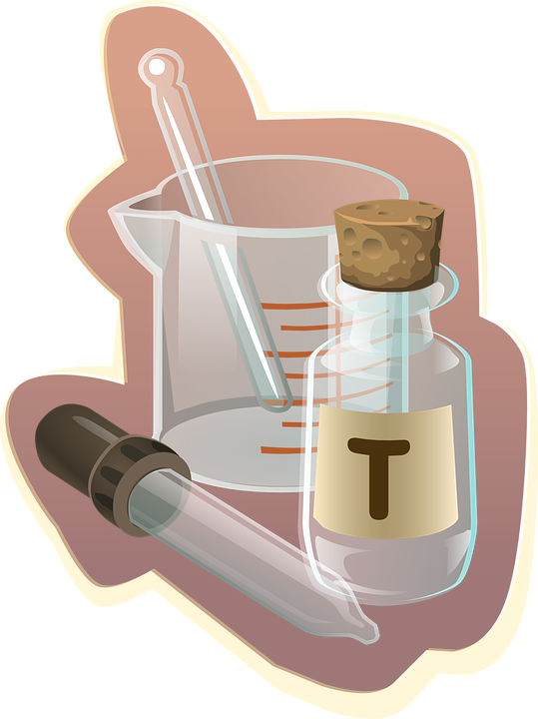
Solution?
Rosie Higman, Marta Teperek, Danny Kingsley:
How about we ask researchers to advocate for good data management and sharing practice within their department?
Slide by Dr Marta Teperek
Notes:
Would like to have one in each department
Ask them to deliver training which has been tailored to the discipline

Slide 6
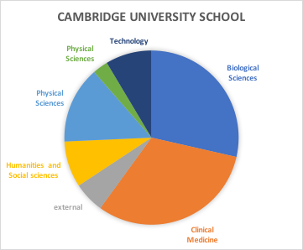
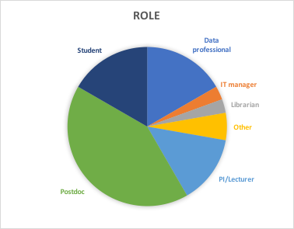
Data Champions – who are they?

Slide 7
Update Data Champion Forum - September 2017
Revealed world of activities by Data Champions!
https://pixabay.com/en/globe-network-connectedness-connect-2679754/

Slide 8
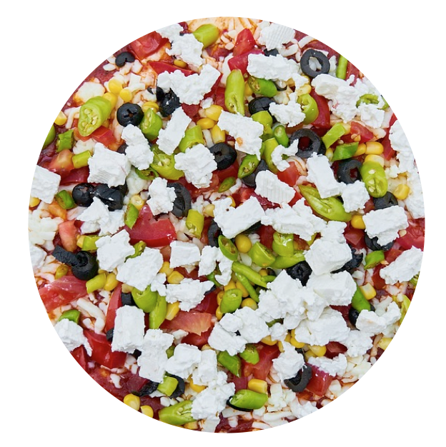
How to solve problems: Suggestions / wish list
Promoting RDM
Engage
senior levels
No
incentives
Fear of
change
Easy access
to RDM
Policy
(Funders)
Templates
&
examples
Only relevant @ point of need
No staff
responsible
Data
Management
Plans
Part of
writing
grants
Don’t know how to do RDM
Long,
boring,
jargon
No links
managers –
researchers
Bite-sized
e-mails
ELNs
https://pixabay.com/en/pizza-dough-delicious-hot-food-2802555/
Notes:
Boring – people like to look at results rather than data organisation
Changing habits - disrganized

Slide 9
How to solve problems: Suggestions / wish list
Convincing People to FAIR research
Fear of being
scooped
Lack
of
expertise
Permissions
Embargoes
Policy
(Funders)
Recognition
for
“negative”
data
Confidentiality
Lack of control over use
D.O.I.s
Problems of
not sharing
IP
Complexity
Lack of infrastructure
More
citation
Recognition
for data set
Data sharing
solutions
Notes:
List cases/examples of problems arising from NOT curating data, e.g. litigation, IP issues

Slide 10
Evolution of Data Champions - From RMD to beyond
Initially:
help with RDM training
works well when there is a local RDM expert and infrastructure support
Also expanded into:
Incorporating “boring” RDM into “interesting” courses
Promoting ELN
and being FAIR researcher

Slide 11
Achievements of Data Champions
Four JISC Data Champions:
Annemarie Eckes
Melissa Scarpate
Andy Thwaites
Sergio Martinez Cuesta

Slide 12
Outstanding issues:
Under-representation of humanities researchers
Lack of local senior support or interest
Variable amount of time to spare by researchers – usually not much!
Need for professionals – solution: Data Stewards program?
Notes:
How to recruit more Data Champions
Communication with researchers

Slide 13
FAIR Data Champions World - future
Direct involvement of (more) researchers
Development of RDM solutions to address researcher’s needs
Training and opportunities for champions (JISC)
International collaborations – like this event!
We are looking forward to working with you!
Notes:
After all, they are the ones doing research ☺

Slide 14
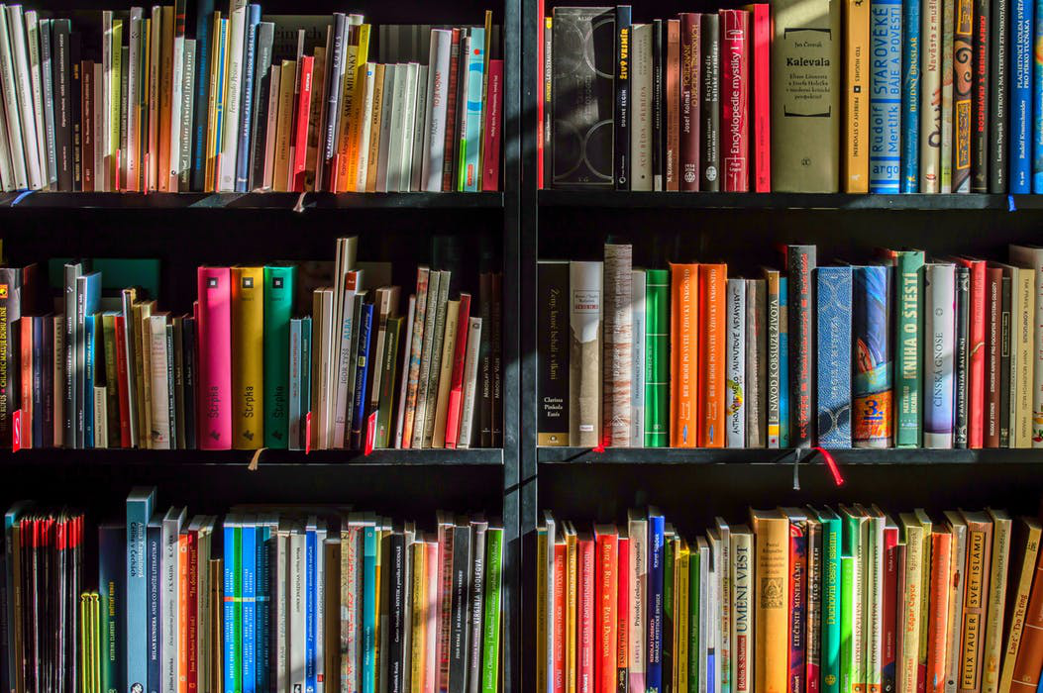
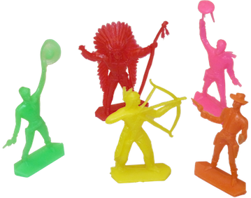
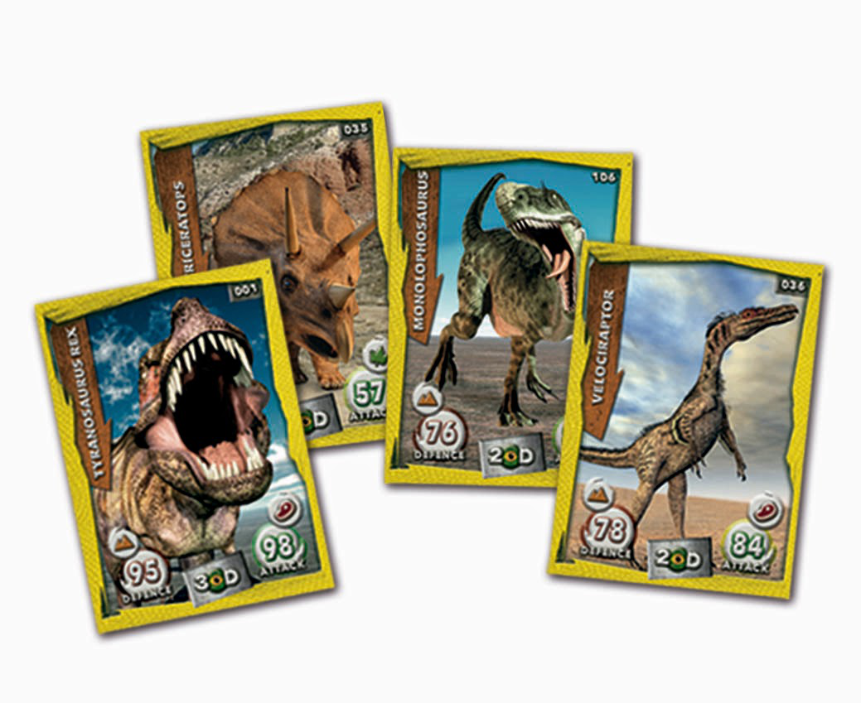

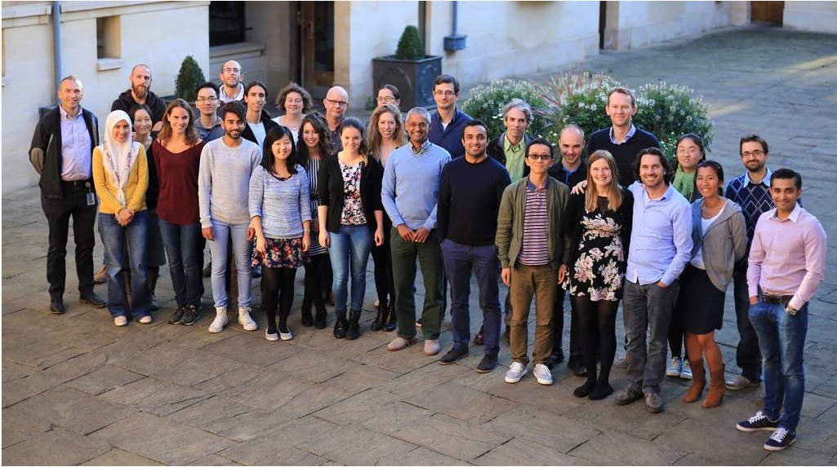
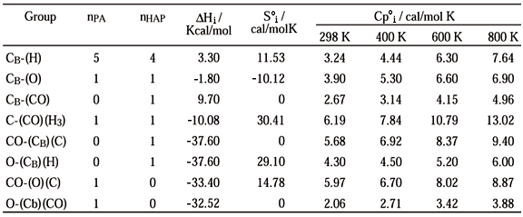
A life’s journey managing data
An early age data management project
My first paid work :)
I need thermodynamics data for my chemistry projects!
Research
c

Slide 15


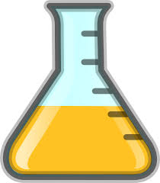


Research project timeline
Private data
Open data
Answering biological questions
Initial experiments
Method optimisation
Write up story
Ideas
Paper
Tests
First scripts
Robust analysis pipeline
Figures Tables
Document computational method
Private code
Public code

Slide 16
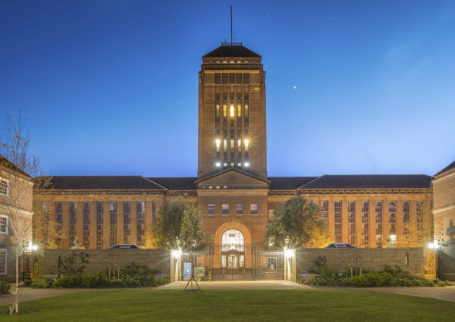
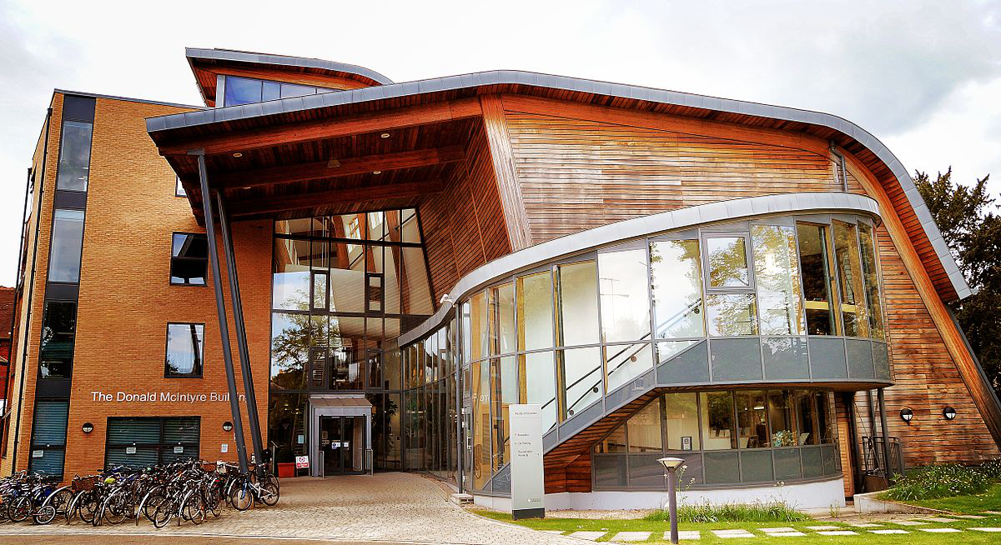
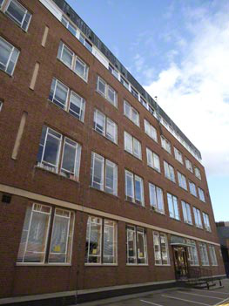
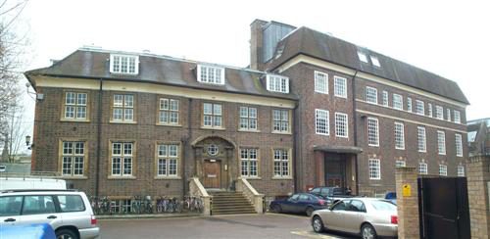
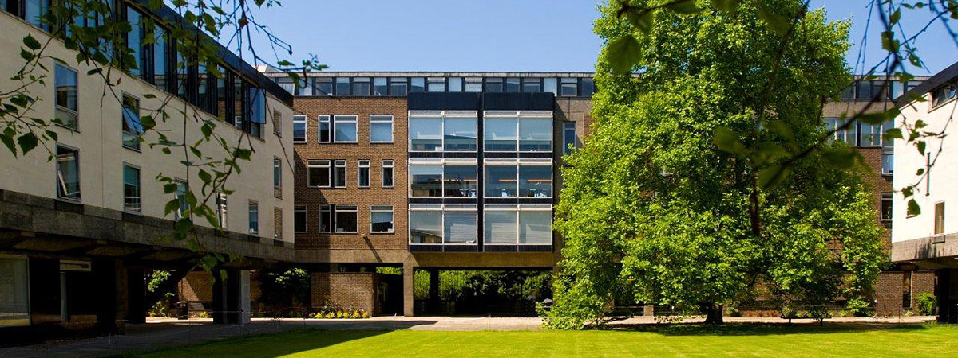
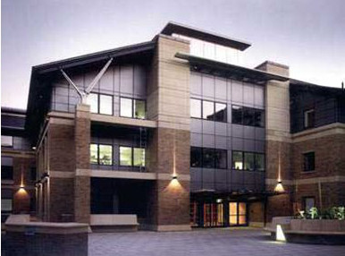
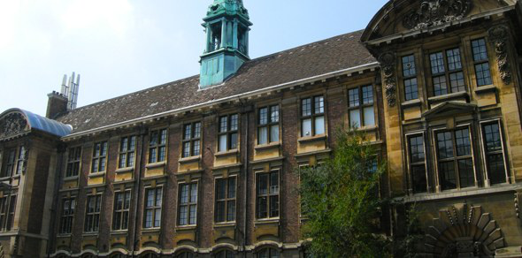
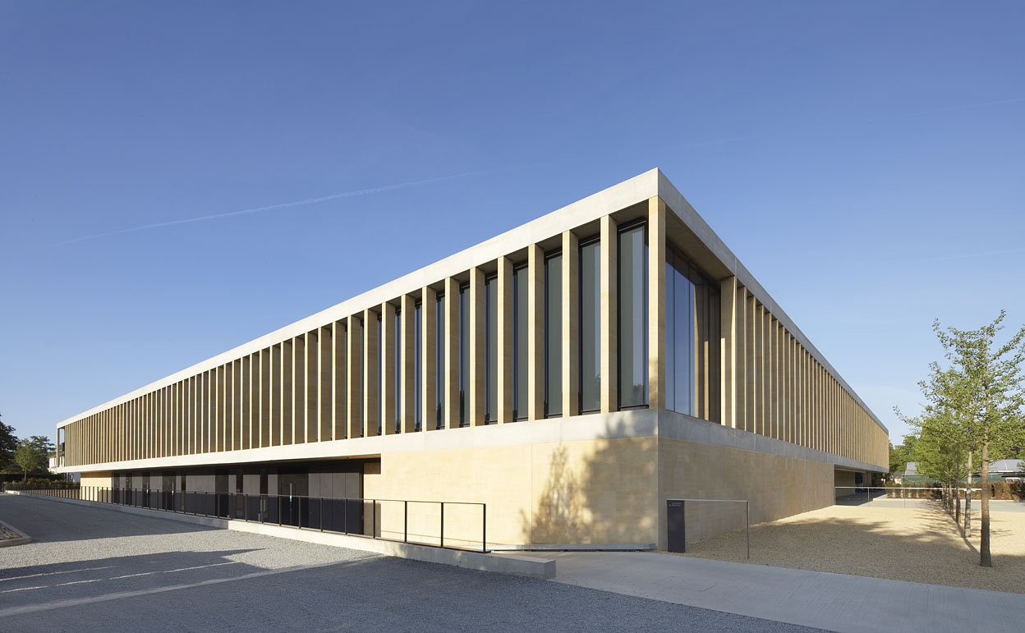
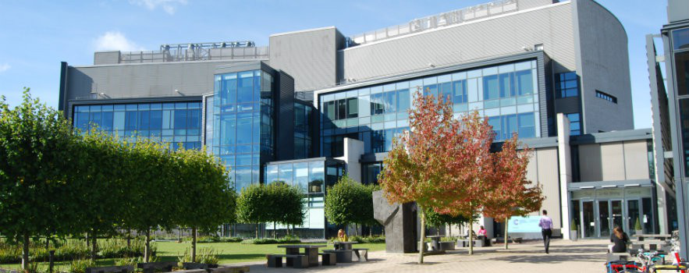
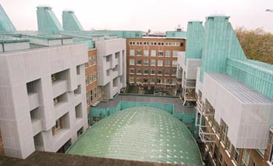
A world of data activities
Forums
Workshops, tutorials and seminars
1-1 meetings
Mentoring schemes
Surveys
The OSC
Education
Psychology
Geography
Economics
Biochemistry
Genetics
Sainsbury
CRUK-CI
Chemistry
...

Slide 17


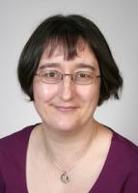
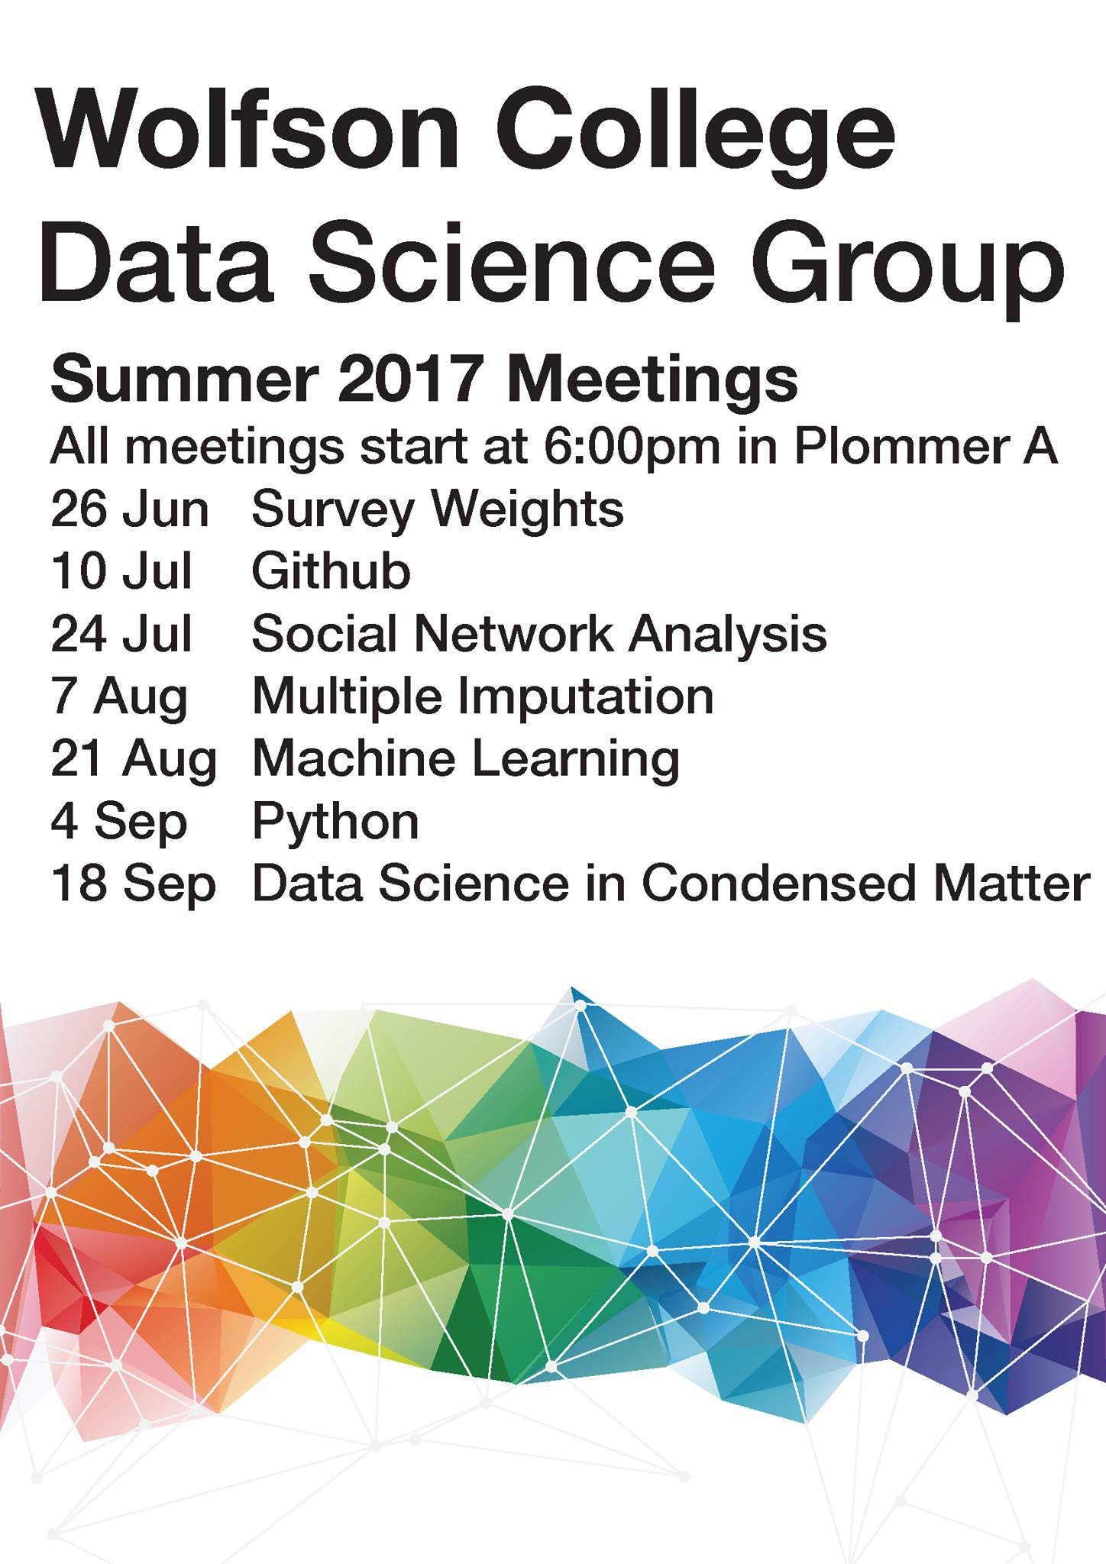
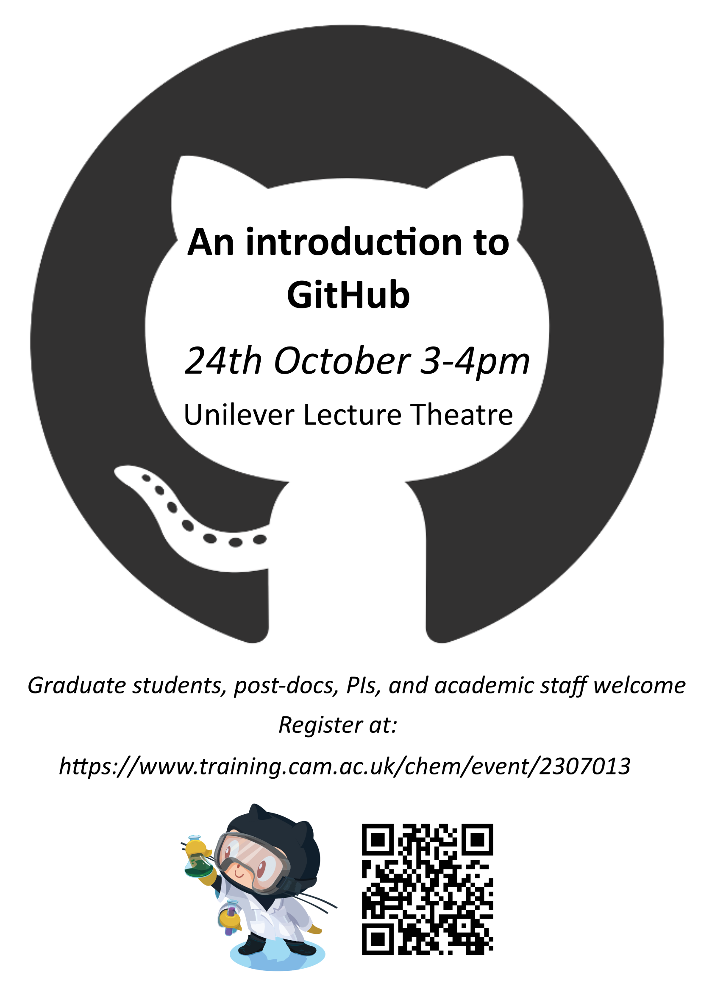
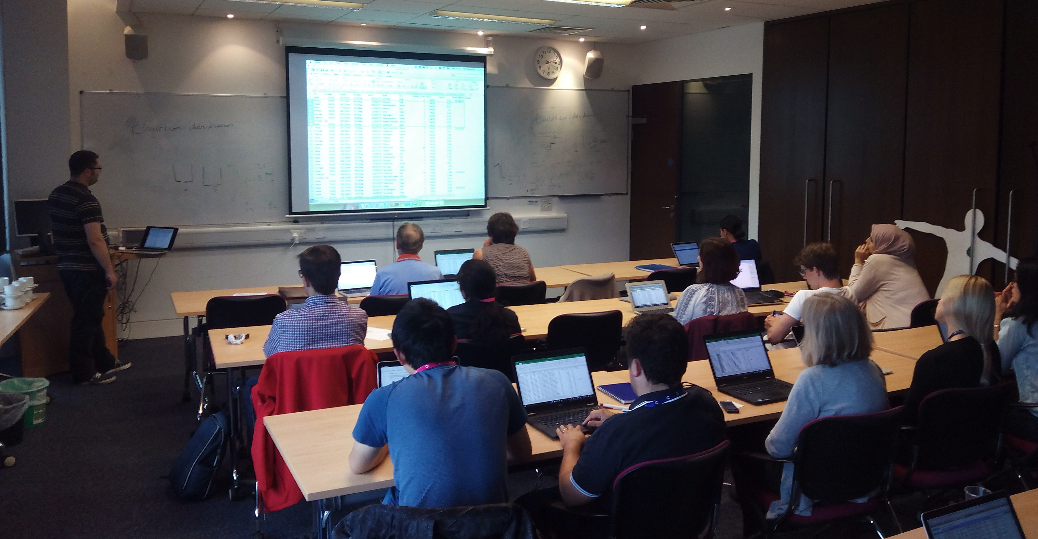
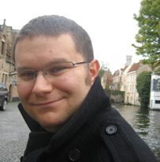
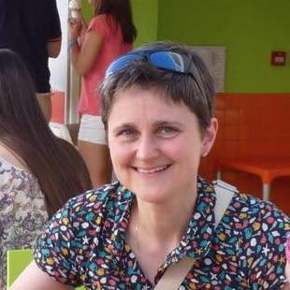
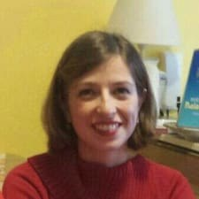
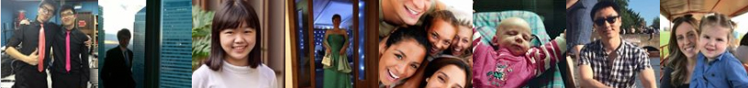
Fortnightly workshops and 1-1 meetings with students and fellows about data topics
Avoiding Data Disasters: best practices for biological sciences
An introduction to Git and GitHub for chemists
Principles on how to work with data more effectively
Managing your code and data using version control
Backing up, naming, organising and exchanging files
Data cleaning using OpenRefine before input in R or Python
Skills for academic success programme
Bioinformatics training
Graduate education programme
https://www.wolfson.cam.ac.uk/datascience
https://datachampcam.github.io/avoid-data-disaster
https://github.com/semacu/training

Slide 18




Thank you!
Questions:
Marta Busse-Wicher
Sergio Martínez Cuesta
mnb29@cam.ac.uk
sermarcue@gmail.com
Engaging researchers in good data management!
15th November 2017
St Catharine’s college, Cambridge
Bringing together international activities, fresh ideas and excitement on effective research data management and sharing

